Slide 1

Introduction to Python

Slide 2
Overview
What is Data Engineering
What is Data Analytics
Data Sources and Types
Introduction to Python for data sciences
Python basics: variables, data types, loops, and functions
Working with Jupyter Notebooks
Group members

Slide 3


Data engineering is the process of designing, building, and managing systems and infrastructure that collect, store, process, and analyze large sets of data. Its goal is to make quality data available for fact-finding and data-driven decision making.
What is Data Engineering

Slide 4

Key elements of data engineering
Data extraction/collection
Data ingestion
Data storage
Data quality and governance
Security and compliance
The operation day of Day Engineering
Monitoring and checking
Optimize the performance
Developing and maintaining
Data cleaning
Collaborate with Other Team

Slide 5
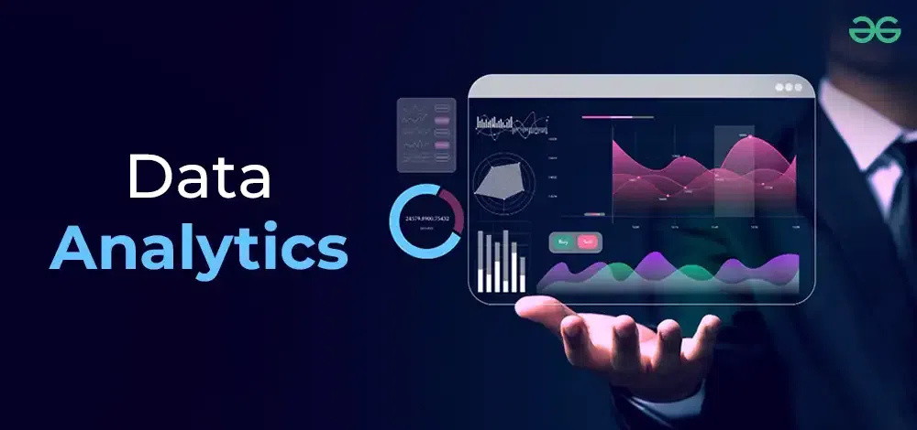

Slide 6



What is Data Analytics
Data analytics is the collection, transformation, and organization of data in order to draw conclusions, make predictions, and drive informed decision making
Add a subheading
01
02
03
04
Descriptive analytics
Diagnostic analytics
Predictive analytics-
Prescriptive analytics
Used to analyze data to understand what happened or what is happening in the data environment
Its detailed data analytics process to understand why something happened
It uses historical data to make accurate predictions about future trends
It takes predictive data to the next level,

Slide 7
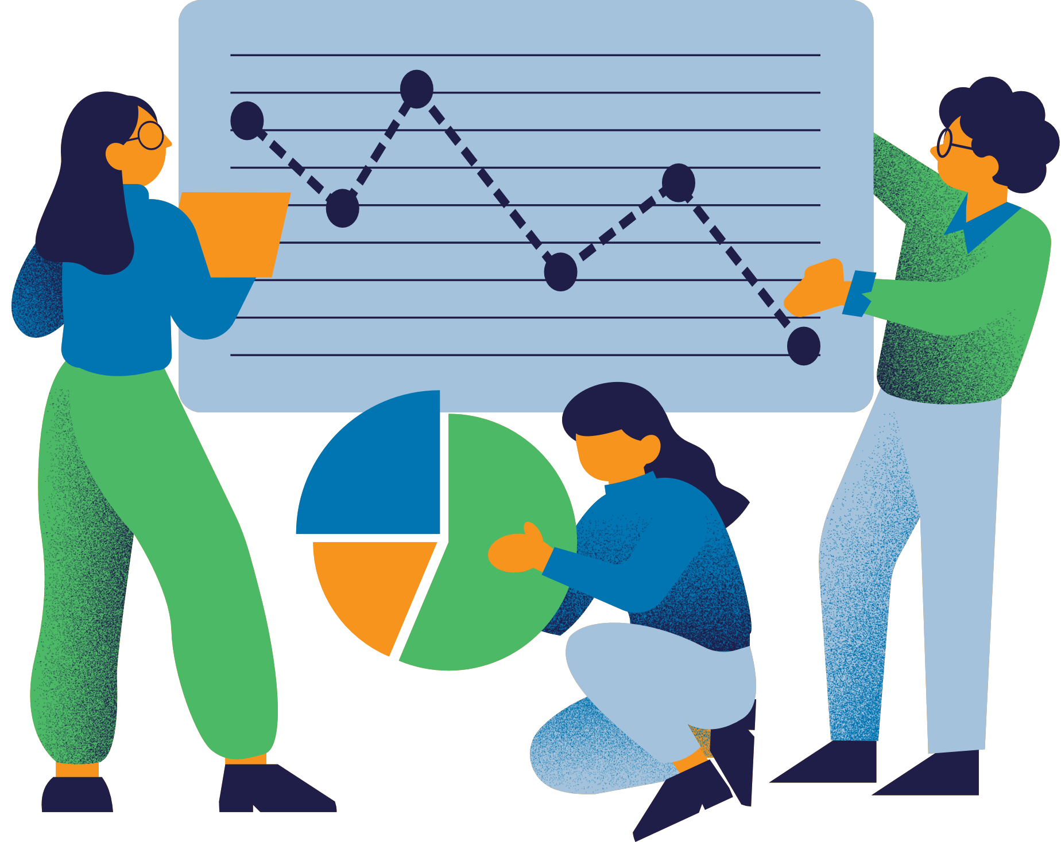
Data Sources
In data engineering and analytics, "data sources" refer to the various locations where raw data originates
Database:
relational databases
NoSQL Databases
Data Warehouses
APIs(Application Programming Interfaces
APIs (Application Programming Interfaces)
Flat Files
CSV(Comma-Separated Values)
JSON(JavaScript Object Notation)

Slide 8
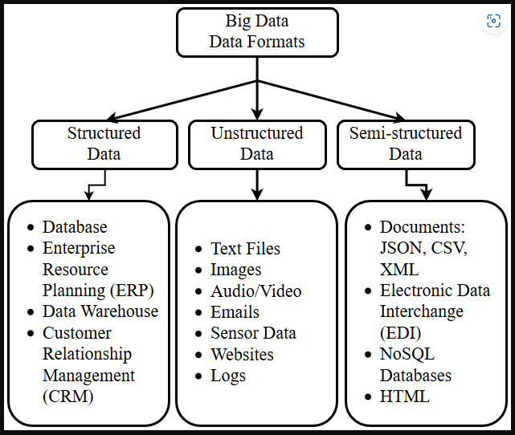
Data Types
Structured Data
Data that have a well-defined and rigid structure and can be formatted in row and column format (Tabular Format).
Semi-Structured
Data that may have a defined structure, but they may or may not follow the structure. examples of semi-structured data are emails, CSVs
Unstructured Data
Data that don’t have a well-defined structure and cannot be formatted in a row and column format. Examples for unstructured data are photos, videos and text files

Slide 9

Introduction to Python for Data Science
Python basics: variables, data types, loops, and functions

Slide 10
Variables and data types
Variables- are containers for storing data value.
Data types are classifications of data that tell the computer how to interpret and manipulate the data.
Types of Data
integer (int)
Float (or Double)
Character (char)
String
Boolean

Slide 11
Loops and Functions
Loops- are programming constructs that allow you to repeat a block of code multiple times until a certain condition is met.
Types of loops
For loop
While loop
Do-while loop
Nested loop
Functions - are a fundamental concept in programming that allow you to encapsulate reusable blocks of code. They take input (parameters), perform operations, and return output (a result).

Slide 12
Working with Jupyter Notebooks
Jupyter Notebook is a free, open-source web application that allows users to create and share interactive documents that combine code, text, images, and other resources.
Features
Jupyter Notebook supports over 40 programming languages, including Python, R, and Scala. It allows users to:
Run code and display results in real time
Collaborate with others by viewing and interacting with the same notebook

Slide 13

Group Members
1)Mahlogonolo Mathekga
2)Yandisa Huluhulu
3)Peter Manhlane
4)Pearl Masutane
5) Omphile Magwaxaza

Slide 14
THANK YOU

